Slide 1

E-Commerce Sales & Order Analysis
Data Preparation & Visualization Project BANA 6760 - Data Visualization By: Supriya, Randal, Jarvis & Manohar

Slide 2
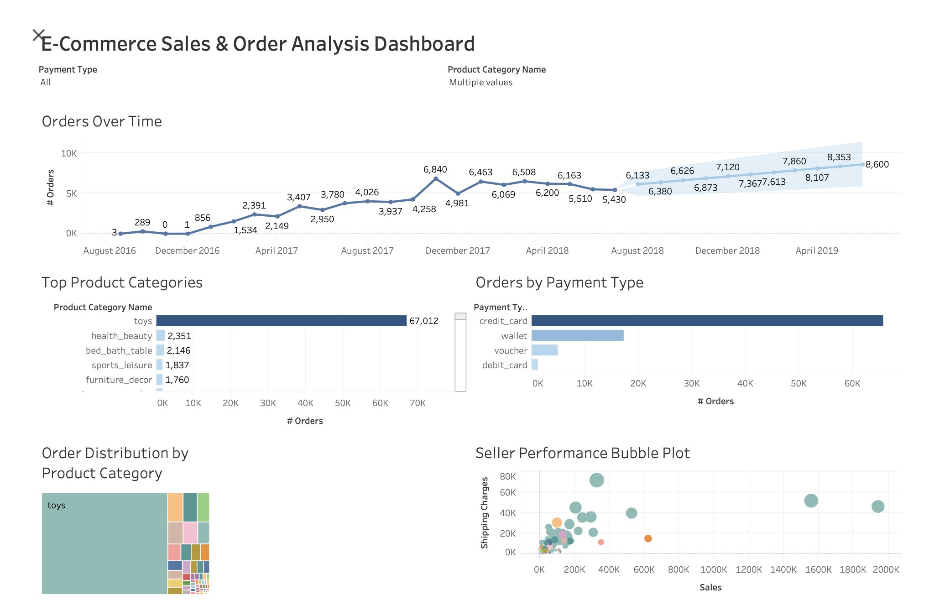

Slide 3
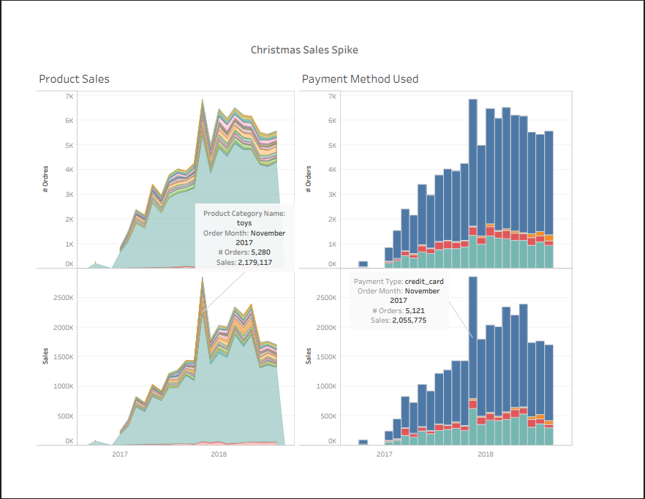

Slide 4
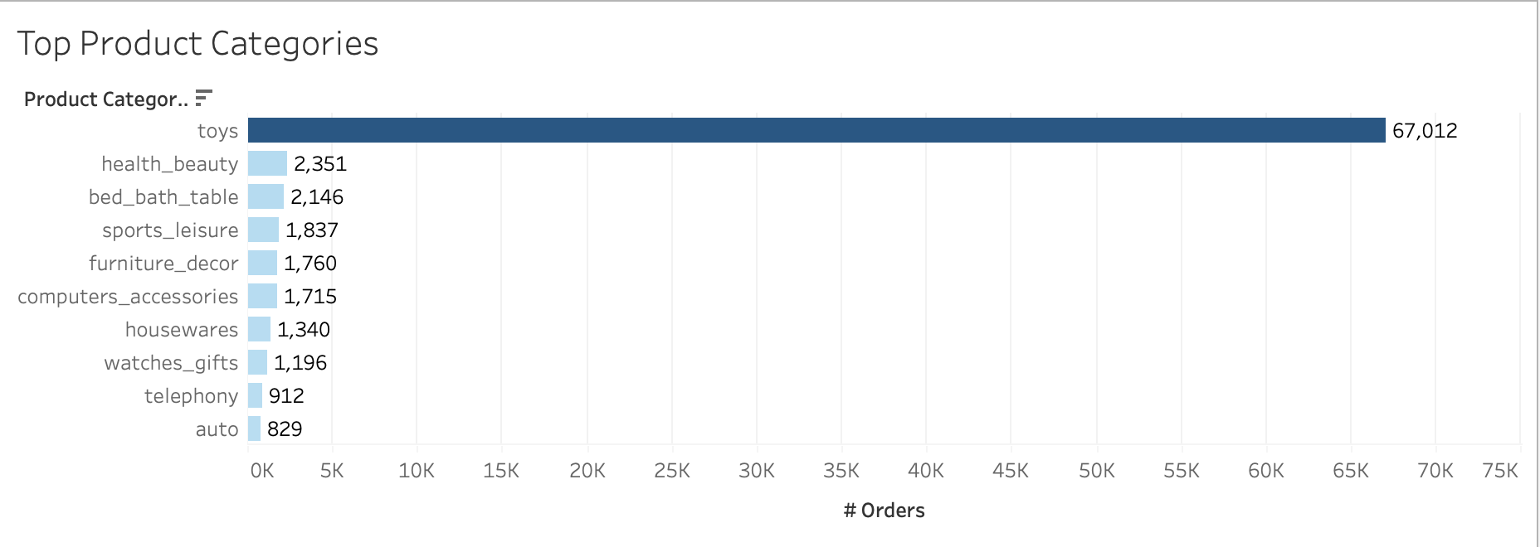

Slide 5
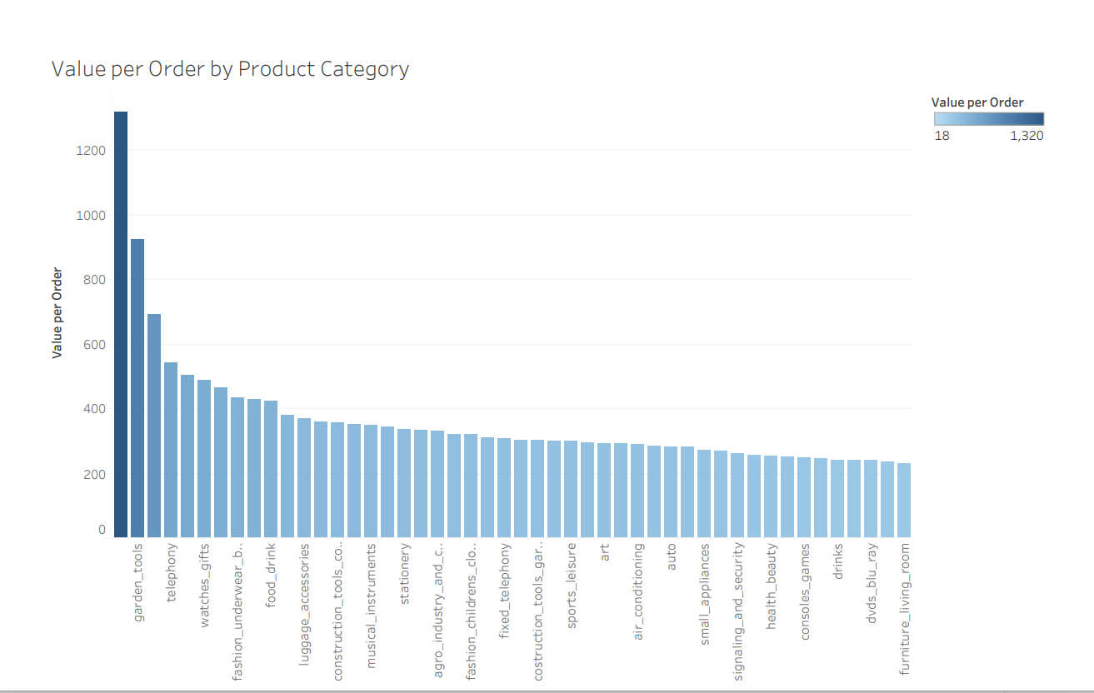

Slide 6
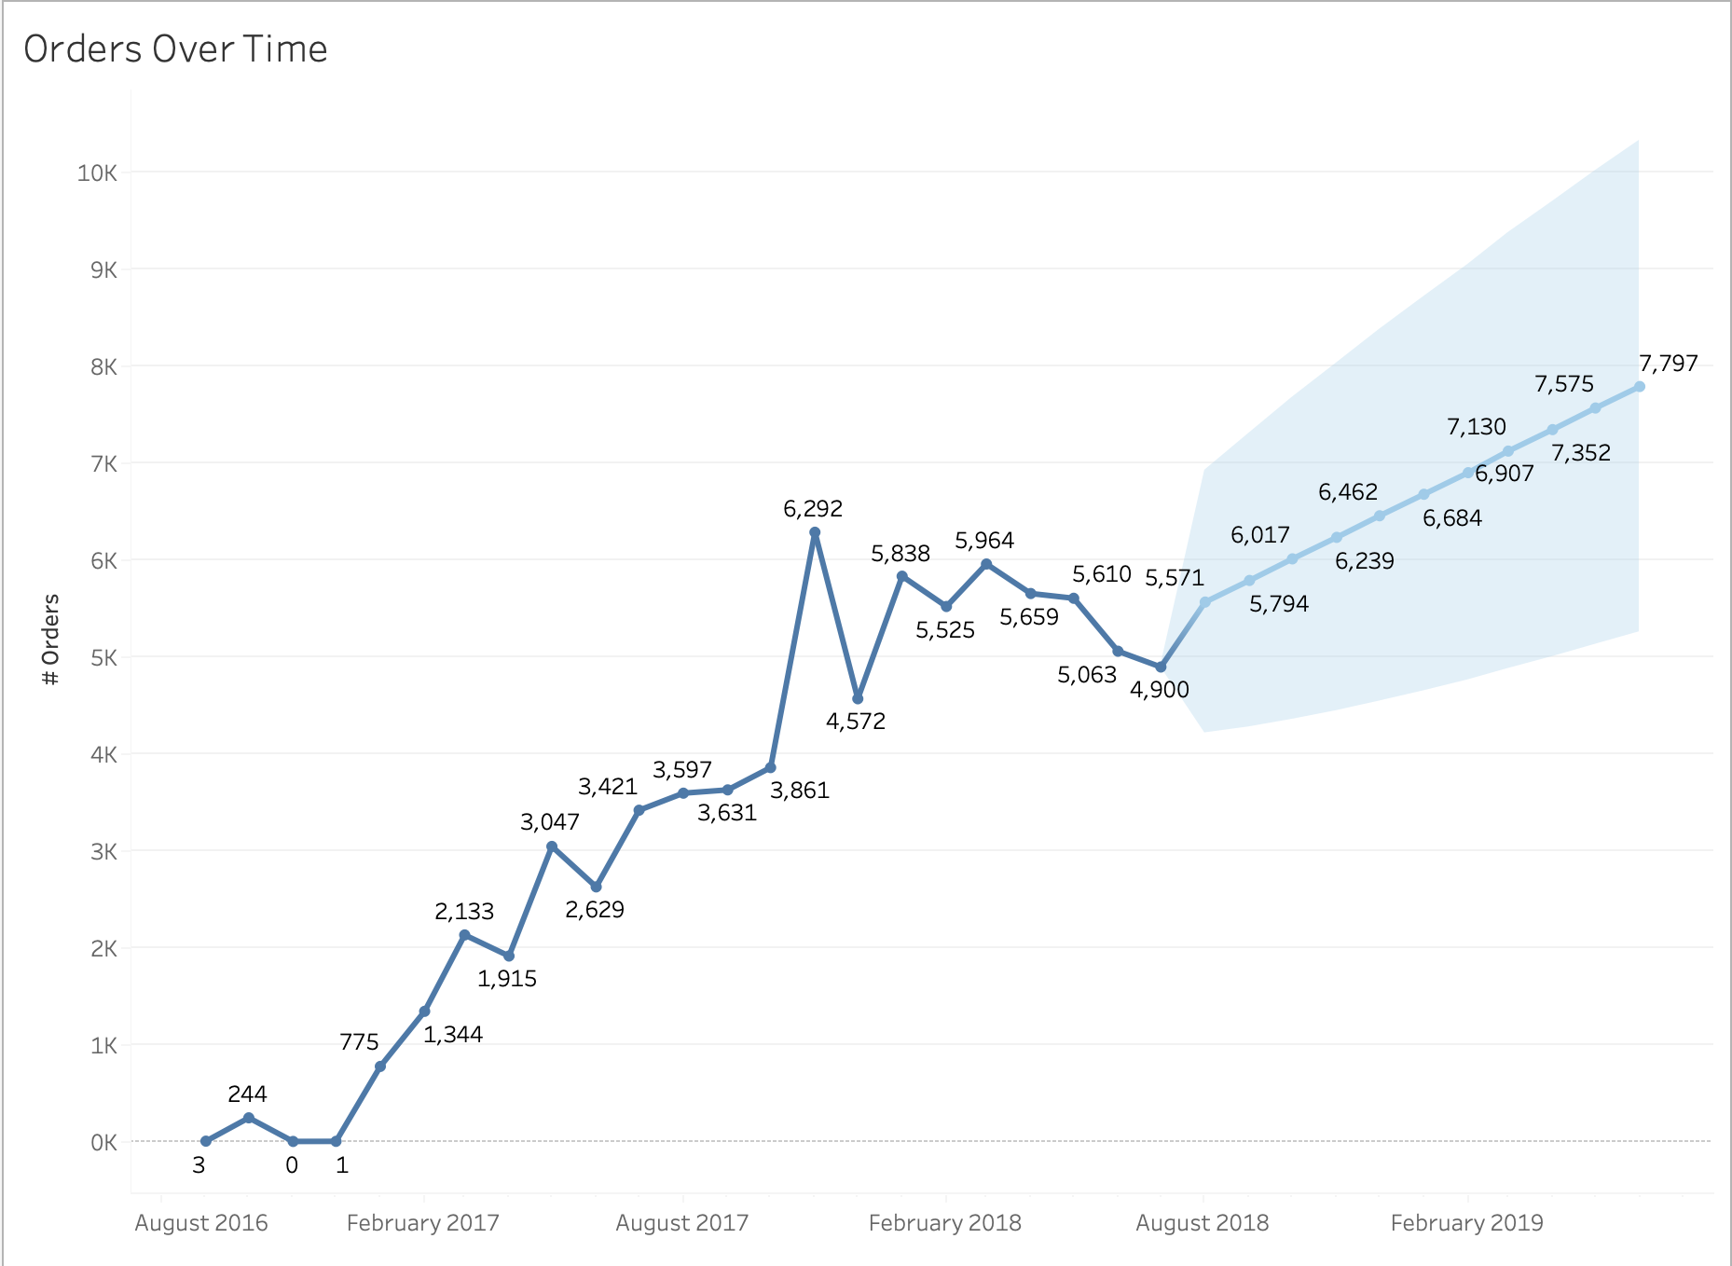
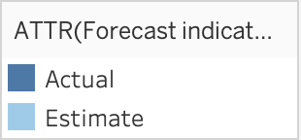

Slide 7
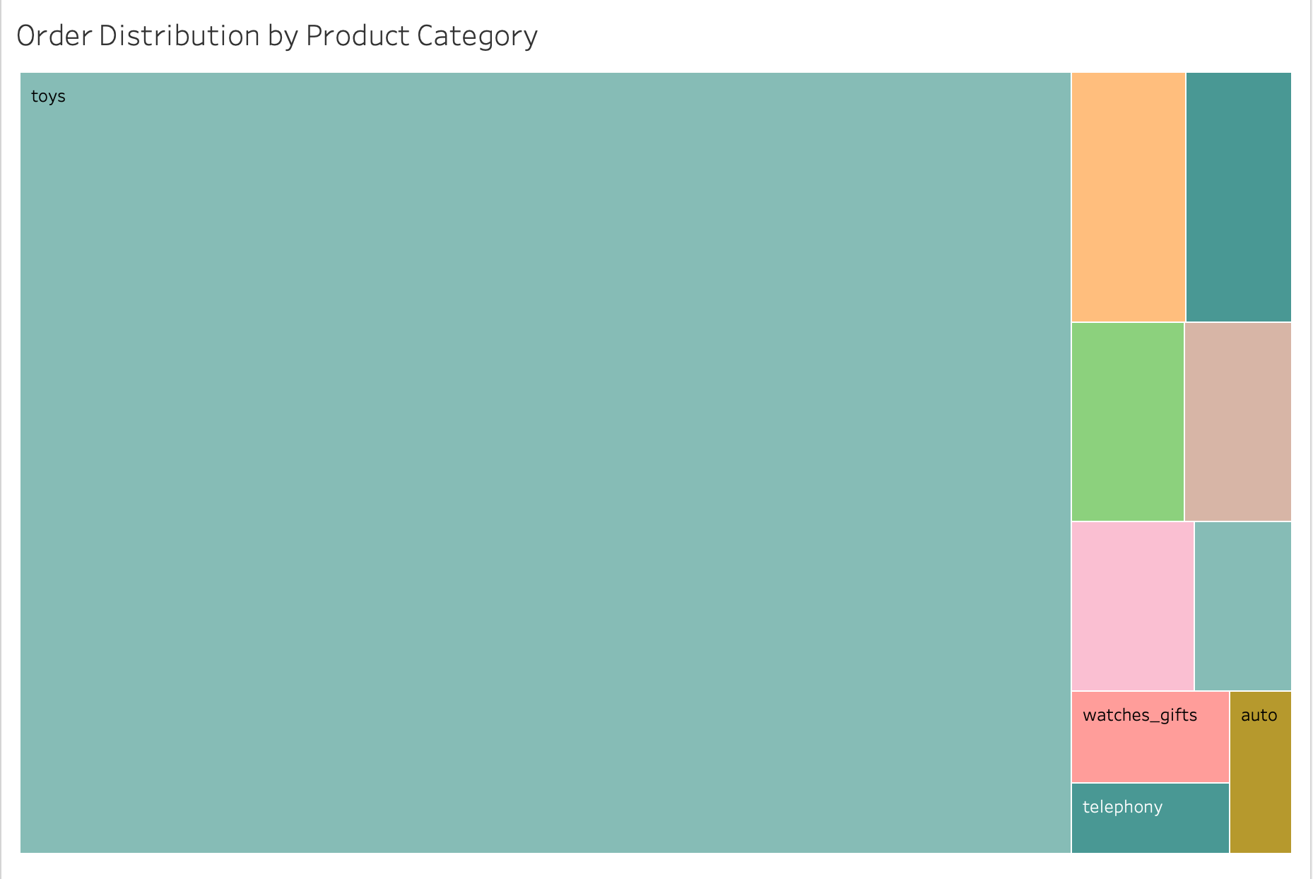
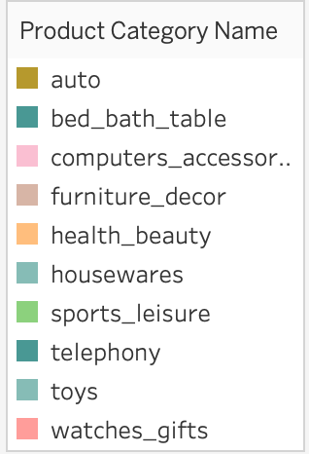

Slide 8
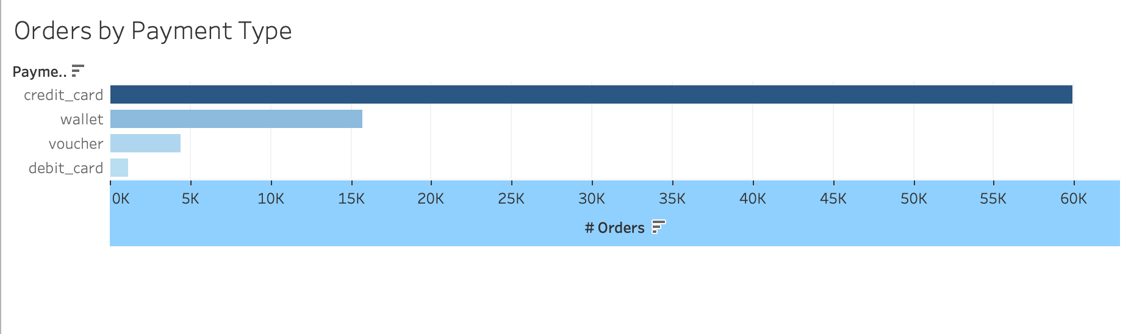

Slide 9
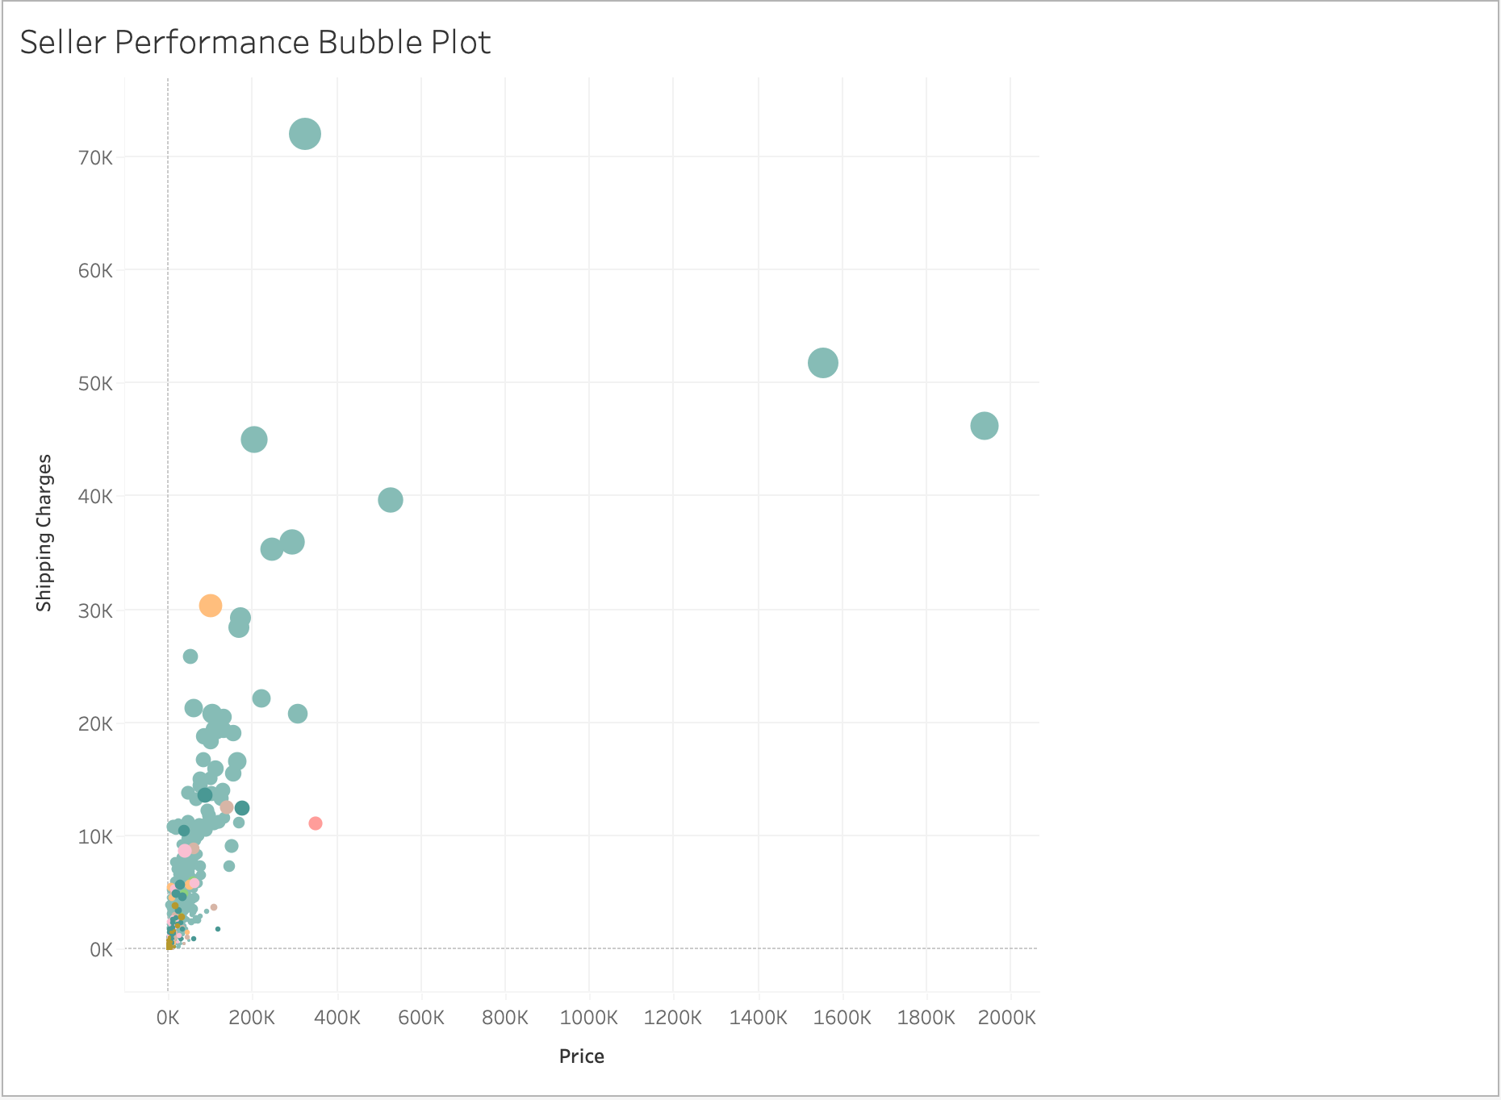
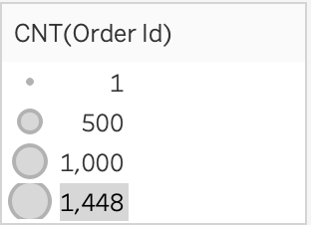

Slide 10
Recommendations
Prioritize top categories: Focus inventory, promotions, and recommendations on leading categories like toys; evaluate whether to curate or consolidate long‑tail categories.
Optimize payment experience: Ensure the credit card payment flow is fast and reliable; selectively promote wallet or voucher options to diversify risk and fees.
Plan around seasonality: Schedule marketing campaigns, discount events, and customer‑support capacity during high‑demand months.
Review shipping pricing: For sellers and categories with high shipping charges relative to price, negotiate better logistics rates or offer shipping promotions to reduce cart abandonment.
Monitor pending orders: Track orders that remain in pending delivery status beyond typical times to create alerts for operations teams to intervene early.

Slide 11
Thank you

